Slide 1
Integrating systems to Digital HR standards
Human Resources (System-Data Project)
Reporter: huynld

Slide 2
Table of Content
1. Operation works
2. Project
2.1. Building Process of Integrating systems to the Digital HR standards
2.2. Integrating Jira Recruit to Digital HR standards
3. Disadvantages of Data in Topica

Slide 3
1. Operation work

Slide 4
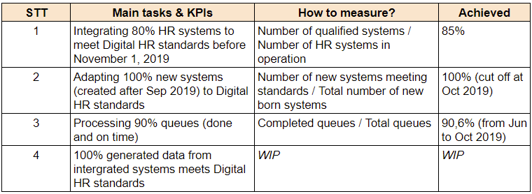
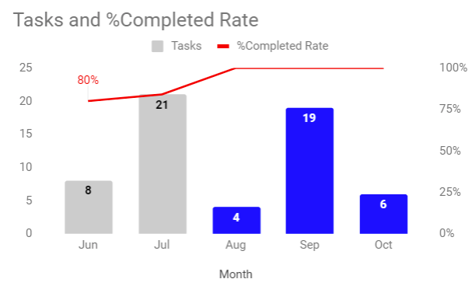
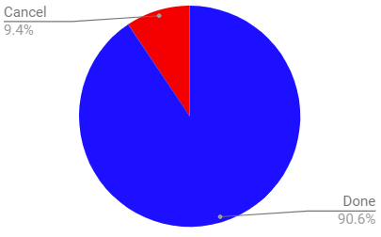
1. Operation work
4 Objectives and Processed successfully 90.6% after 5 months (over target)
Highlight:
1. Objective 1: Successfully integrated 44/52 HR systems (active)
2. Object 2: 2 systems VMR & Announcement are building and following Digital HR systems
3. Object 3: Received 64 ad hoc tasks
Completed: 58 (~91%)
2 months with most queues: Jul (21 queues) and Sep (19 queues) due to the 2 phases of Project

Slide 5
2. Project
(Project 1: Building Process of Integrating systems to the Digital HR standards)

Slide 6
2.1. Project 1: Overall project
Problem - Digital HR standards - Integrating and Documents
Identifying problems
Building Digital HR standards
Integrating systems
Documents
1. Systems don’t integrate
2. No consistent data between systems (formatting, mixed letters and numbers, etc.)
3. Unable to exploit data from HR systems
1. Operating principles and regulations
2. Process of integrating systems
3. Mechanism for evaluating and swirling data
4. The human resource operating
Integrating HR's operating systems according to Digital HR standards
Document and close the project in Oct

Slide 7
2.1. Project 1: Building Digital HR standards
8 Rules of Digital HR standards (Jul 15, 2019)
HD100
All categories entered into ListMaster must have a signed paper or online signature
HD200
All other systems' lists must be obtained from ListMaster
HD300
If the list is not taken from the ListMaster, there must be an API associated with SAP, for example Checkin, HRop
HD400
All employee data must be obtained from HKT Data
HD500
If employee data is not obtained from HKT Data, there must be an API associated with SAP, for example HRoper
HD600
Do not accept "SAME LIST"* but the data on ListMaster is different
For example: on SAP there is fund center but on Special List there is CDT, for example on SAP it is profits center but on Special list there is SP
For the portfolio Topican wants to manage, which SAP does not have, ListMaster is allowed to manage it separately
(*) "SAME CATEGORY" means: same management meaning, same management goals
HD800
All application data must flow into DDS
HD900
All long-term principles above must always be followed.
In the short term, violating systems must be resolved within the required time, otherwise they will be removed.
For example: Jira recruitment is not getting directory data from LM so it violates HD200, the team is given a grace period until July 31, 2019.

Slide 8
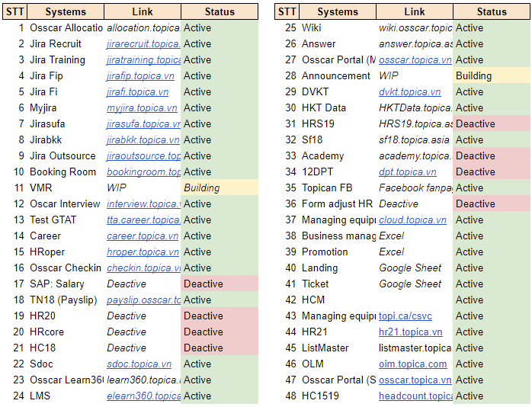
2.1. Project 1: Integrating systems result
Out of 48 systems: Integrated successfully 38, deactivate 8, newly building 2
Highlight:
Main problems:
Enormous data which is not following Digital HR standards
Needed to decide whether to convert existing data or cut-off and move on
Solutions:
Deactivated 8 out-of-date systems
Converted 38/48 systems only

Slide 9
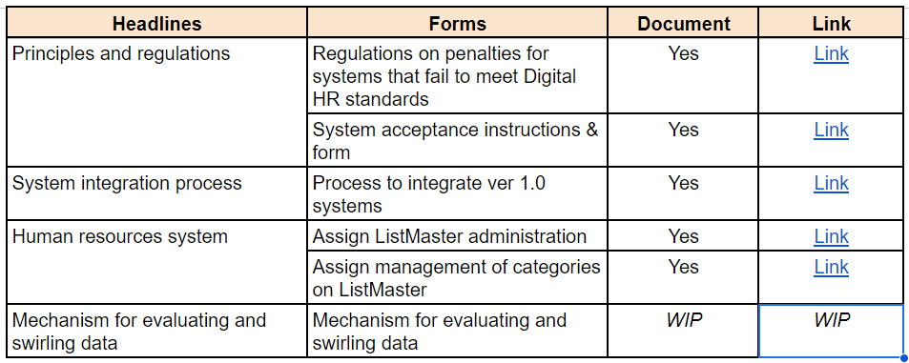
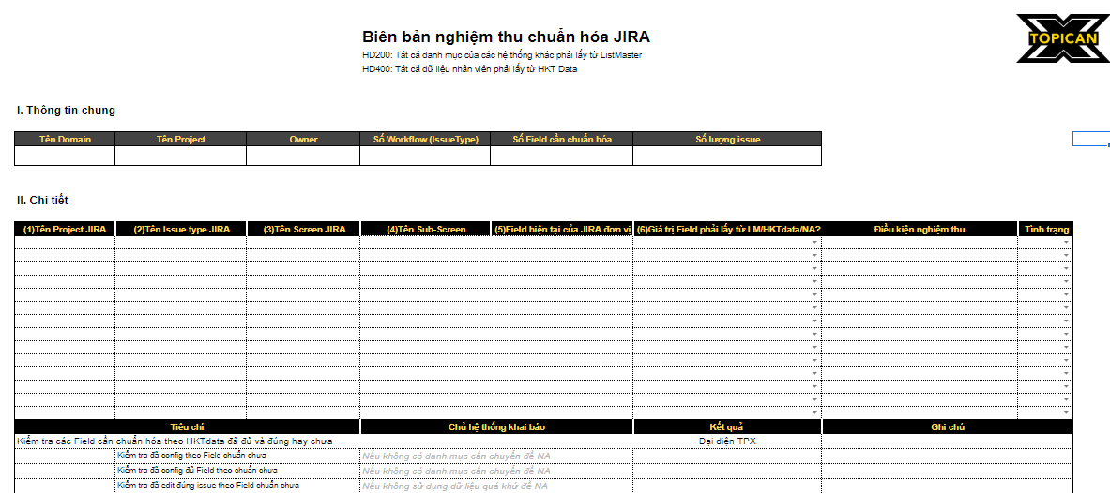
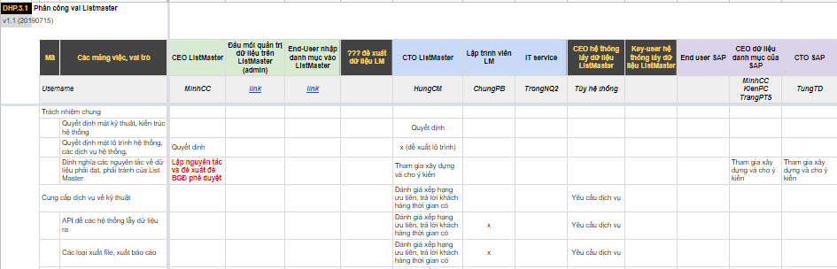
2.1. Project 1: Project Documents
All forms and documents related to Project

Slide 10
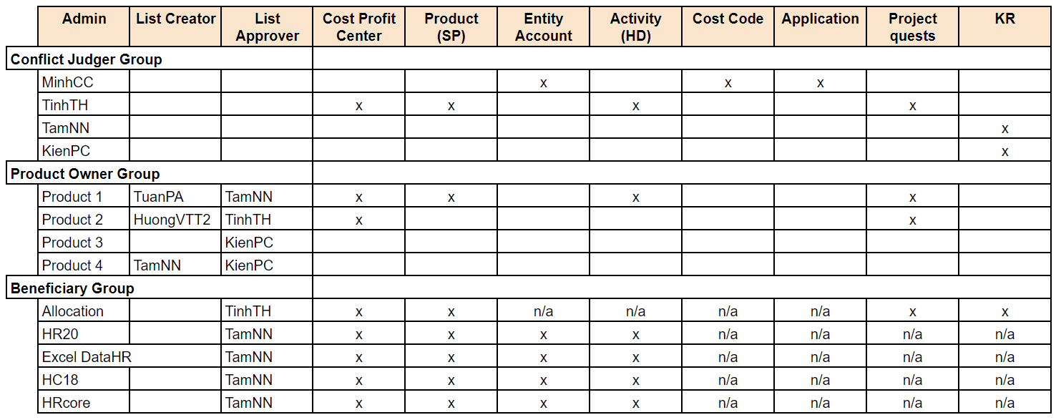
2.1. Project 1: Documents about Human resources system
Escalating order from List Approver to Admin and from Beneficiary Group to Conflict Judger Group
Highlight:
If conflicts happen, the order to make final decisions will escalate as below:
+ List Approver (first) < List Creator < Admin (final decisions)
+ Beneficial Group (first) < Product Owner Group < Conflict Judger Group (final decisions)

Slide 11
2. Project
(Project 2: Integrating Jira Recruit according to Digital HR standards)

Slide 12
2.2. Project 2: Integrating Jira Recruit to Digital HR systems
Overview : Target - KPI - Results
Target
KPI
Results
Integrating Jira Recruit following the Digital HR standards
1. Converting 50% workflows operating before Sep 4, 2019
2. Securing 100% workflows created after Sep 4, 2019
1. Exceeded target and reached 100% (converted 22/22 wf = 209 IssueType List)
2. 4/4 new wf met standard (= 100% target)

Slide 13
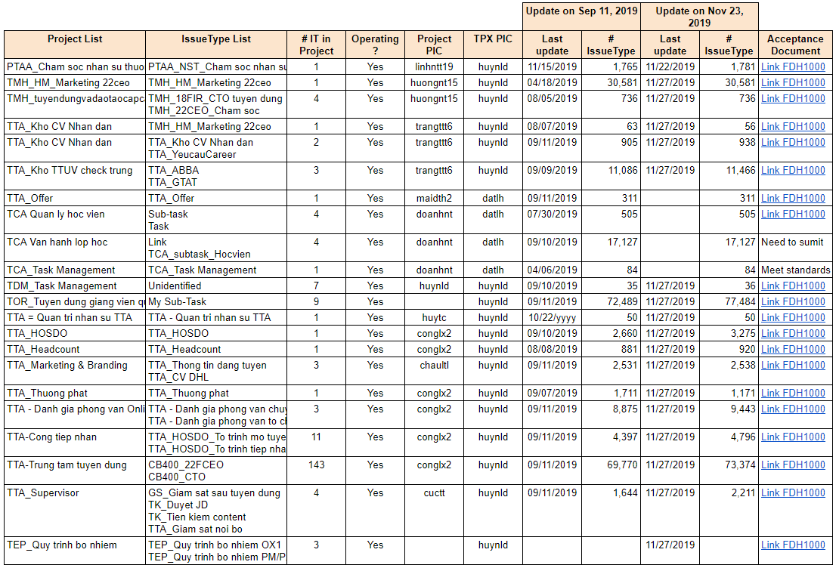
2.2. Project 2: Result 22 Projects integrated
Converted 22 Projects with 209 IssueType list meeting the Standards
Highlight:
Cut-off at 2 time :
On Sep 11, 2019: Successfully converted ~228k IssueType data
On Nov 23, 2019: Increased ~10,6k data cells.
> Cleaned a total of ~238,9k data cells (followed the Digital HR standards and be ready to exploit)
> Created an increase of 13,139,200 VND (according to data conversion rate of TuND)

Slide 14
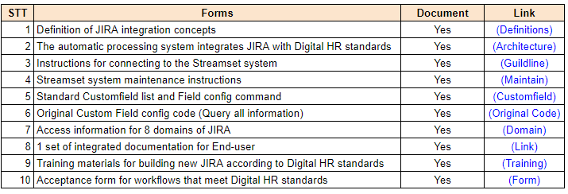
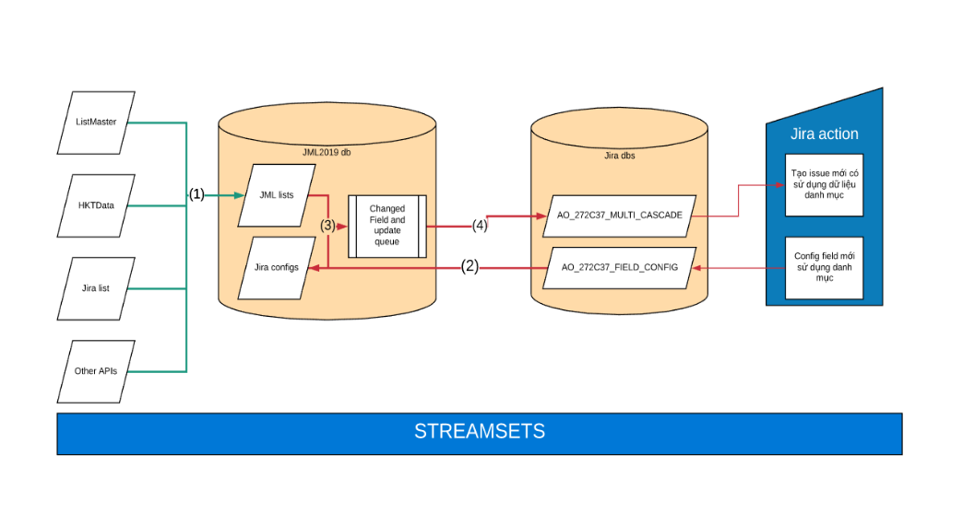
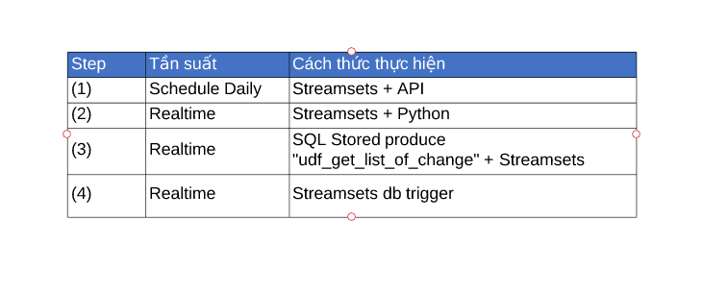
2.2. Project 2: Project Documents
All forms and documents related to Project
Highlight 1:
Explanation:
Old Field will be replaced by common Field Cascade. Query directly from general DB (between LM and HKTdata)
Common Field Cascade uses select choice format with parent relationship. Values must be from LM or HKT database
Common Field Cascade will no be used for changeable fields such as Ranking, Unit, or Personal information (Phone, Banking account, Personal Email)

Slide 15
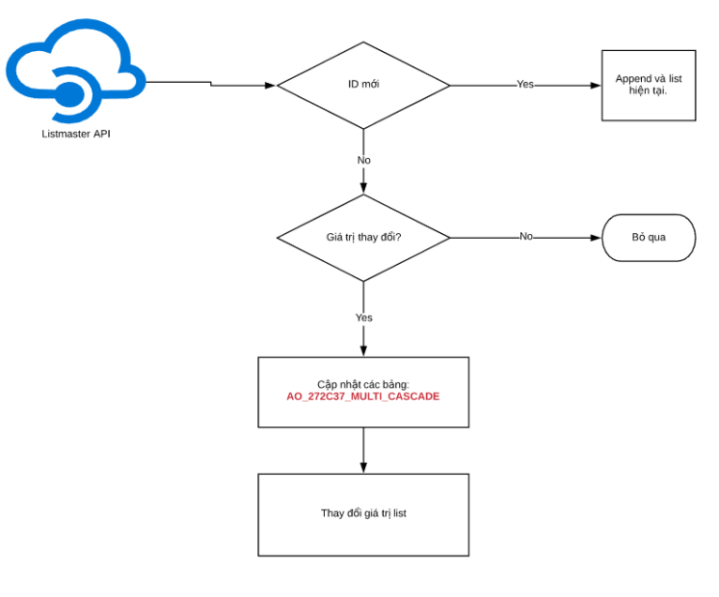
2.2. Project 2: Project Documents
Process when ListMaster changes values leading to the change of Jira Recruit
Highlight :
Listmaster updating:
Pipeline updates weekly
If there is new ID on ListMaster, values related on Jira will be updated as well

Slide 16
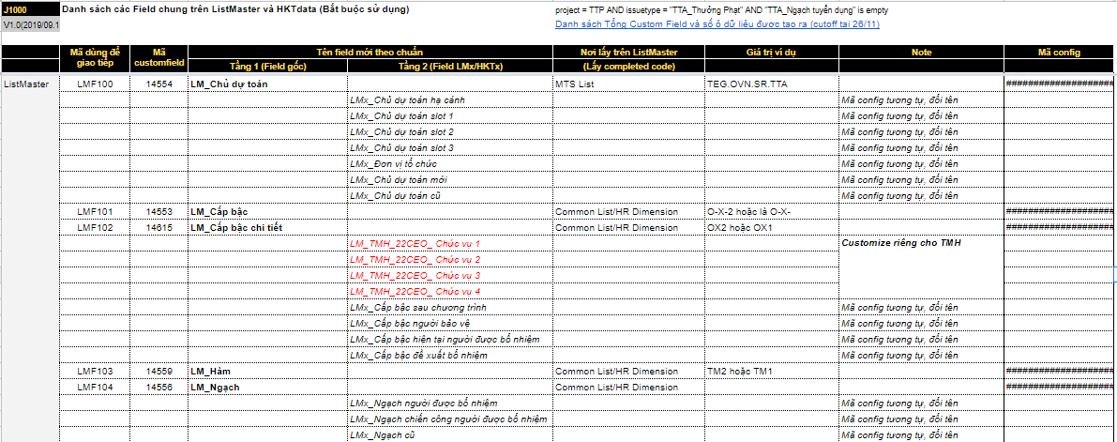
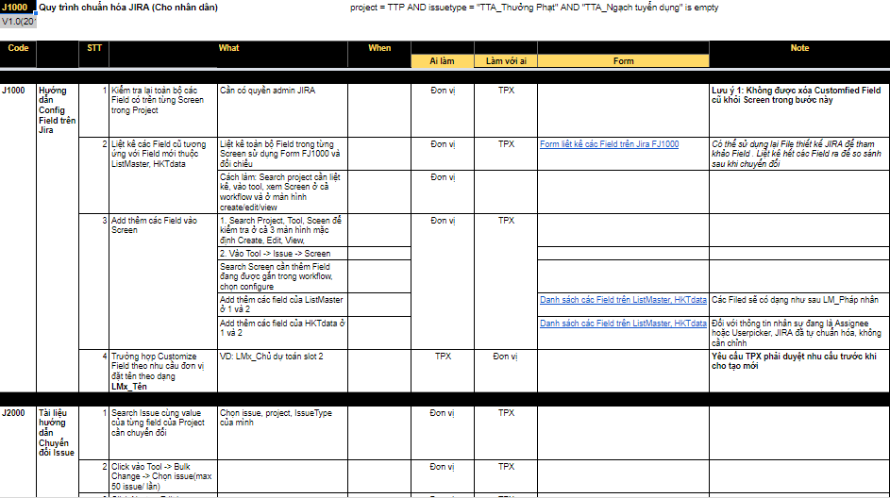
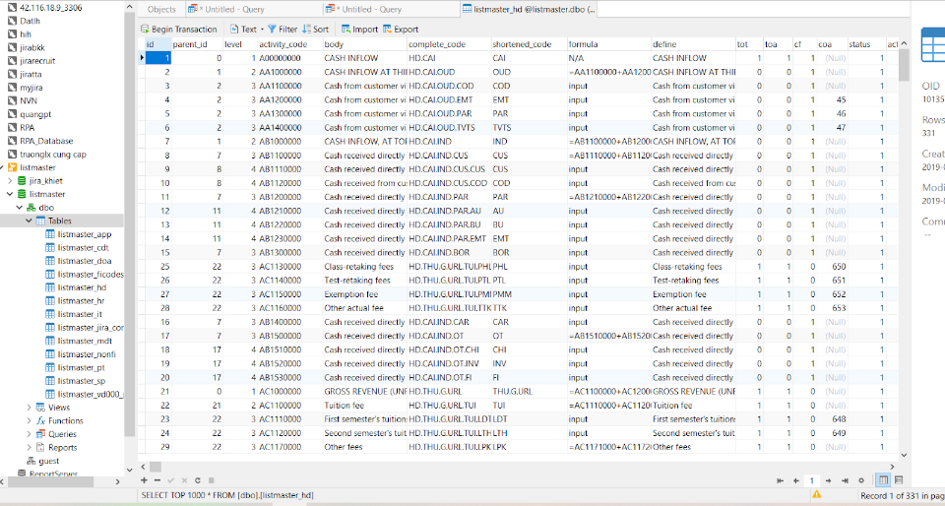

Slide 17
3. Disadvantages of Data before Integrating
There were 3 main drawbacks with current data in Topica: Inconsistency, Unusable Data and Conceptual heterogeneous in Systems
Unusable data for reports
For example: Old Field ‘Ranking’ is out-of-date but still keeps it in the process (Ranking NX is replaced by OX1 but still have both ranking title in the systems) leading to the false of report in HR
03
Data is inconsistent
For example: Field ‘Name’ vary from Fullname, Name, Shortcut, Nickname (Duc Huy, Nguyen Le Duc Huy, Huynld,...)
01
02
Conceptual heterogeneous systems
For example: The evaluation team needs data about direct management but does not know whether to get it from HR21 (head of Org Unit) or from the Checkin system.

Slide 18

Thank you
Nguyen Le Duc Huy
huynld@topica.vn

